Slide 1


Barnfields Primary School
Year 2
SCHOOL VISION:
At Barnfields, academic excellence runs alongside sporting and artistic excellence. The whole child is nurtured as positive wellbeing is encouraged and supported, enabling them to make outstanding progress across the curriculum. This learning is underpinned by strong values that encourage and guide the children through the rest of their academic journey and as citizens of the future.
Notes:
Please share the school vision, particularly the three aspects of the school vision (academic, sporting and artistic)
JM

Slide 2
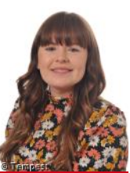
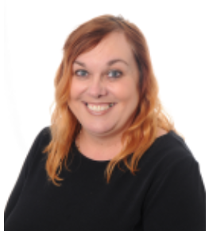
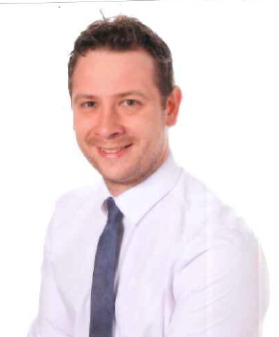
Meet the Teachers
Mr Murday
Class Teacher and KS1 Phase Leader
Miss Moorcroft
Class Teacher
Miss Turner
Classroom Assistance
Notes:
Adapt to include the Phase Leader, teachers and any support staff. JM

Slide 3
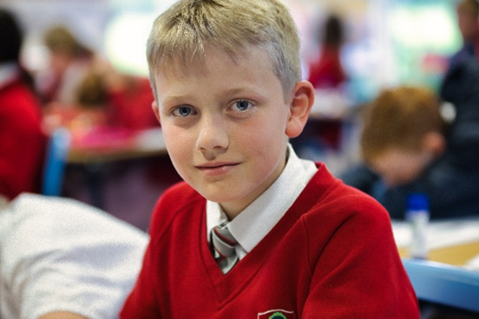
The School Day
Gates will open at 8:40am and close at 8:50am for all children.
Registers will be completed between 8:50am and 9am.
Reception and Yr1 will enter during the side gate next to the school office.
Yr2-Yr6 will enter through the main school gate behind the Co-Op.
Learning will begin promptly when registration closes.
Children are encouraged to be increasingly independent. They will be dropped off at the school gates in the morning, with the exception of Reception and Yr1.
Children will be dismissed at the end of the day (same as the morning gate) at the following times:
  Reception: 3:10pm
  Yr1 – Yr3: 3:15pm
  Yr4, Yr5, Yr6: 3:20pm
Notes:
There will be some slight changes to the entrance/exit procedures from September. We don’t need to stagger the mornings anymore and all children will enter together. We will slightly stagger them at the end of the day for safeguarding purposes – we need to ensure that we can see them out safely. ZM

Slide 4
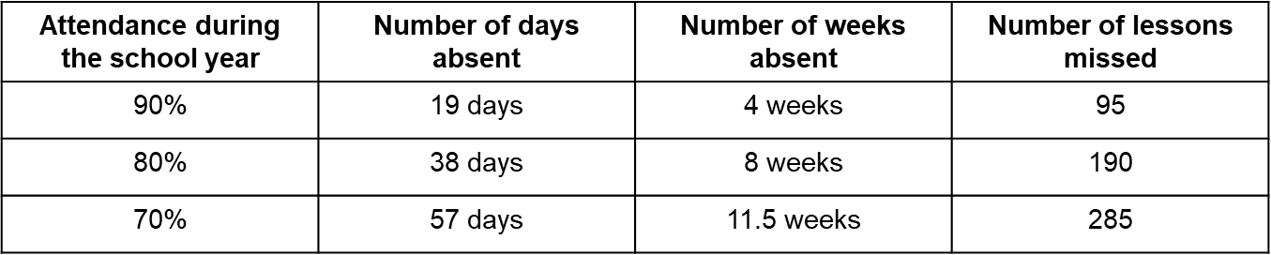

The Importance of Attendance
Regular school attendance is the key to enabling children and young people to maximise the educational opportunities available to them and become emotionally resilient, confident and competent adults who are able to realise their full potential and make a positive contribution to their community. Promoting excellent attendance is the responsibility of the whole school community.
Notes:
Please explain the importance of regular attendance and the impact that absences can have on learning and rates of progress. Our whole school attendance is currently 93% for this year; we really need to improve on this. ZM

Slide 5
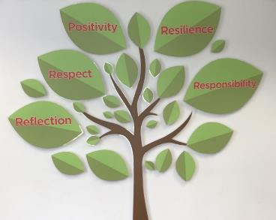
Expectations at Barnfields
Barnfields’ Values of Respect, Reflection, Resilience, Responsibility and Positivity are at the heart of all of the children’s actions.
Every child looks smart in the correct school uniform and is proud to respect the Barnfields Badge.
Excellent behaviour at all times will be the responsibility of the child; they will be asked to reflect on their choices and consequences may be incurred.
There will be mutual respect from all members of our school community at all times.
Notes:
JM

Slide 6
School Uniform
All pupils are expected to wear the uniform in full to school every day.
At Barnfields, children wear white collared shirts (long or short-sleeved), together with our school tie. A red school cardigan or V-necked jumper with the school logo must also be worn. This is accompanied by a grey/red tartan skirt/pinafore dress or black trousers (no leggings, jeans or combat style). Black tights and black, white or grey socks with sensible black shoes or plain black boots (no trainers or pumps) for the winter months must also be worn.
We encourage everyone to wear our main school uniform all year round. However, in the summer, children are able to wear black or grey shorts, or a red and white checked summer dress with white socks.
Please note that our PTFA, for a small donation, sell good quality second hand uniform.
Notes:
You may want to mentioned naming items of clothing here. ZM

Slide 7
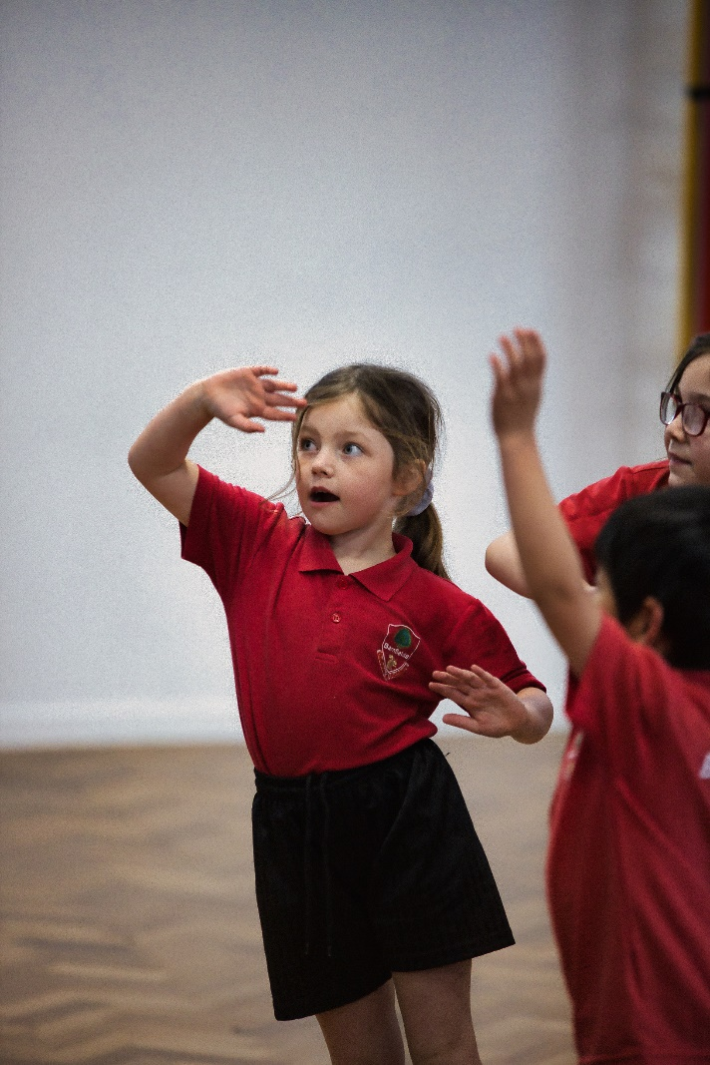
PE Kit
PE kits are an essential part of physical education. They ensure children remain safe whilst being active and are key for personal hygiene. Children will be expected to wear a red t-shirt with logo, black shorts or skirt and black or white socks. A Barnfields hoody is optional. We encourage children to wear inexpensive trainers; we do not stipulate a colour. Additional warm clothing e.g. tracksuit can also be worn when necessary.
‘Let’s Dance’ is not part of the Barnfields PE Kit and should only be worn for after school clubs only.
Notes:
Please reiterate that ‘Let’s Dance’ is not school PE kit – we need to really clamp down on this from September as more and more children are wearing the incorrect uniform. This is club attire. Parents will be of PE days in September. ZM

Slide 8
Jewellery
The wearing of jewellery in school is not permitted with exception of one pair of plain studded earrings and watches. This is to ensure the health and safety of the children. Children are not allowed to wear any jewellery for PE and must be able to remove earrings by themselves as staff are not allowed to assist or tape them up. Therefore, if children are unable to remove their own earrings, please do not allow them to wear them on PE days.
Please remember that PE is a legal requirement in which children must participate. With this in mind, we suggest that children having ears pierced do so at the beginning of the summer holiday.
Notes:
ZM

Slide 9
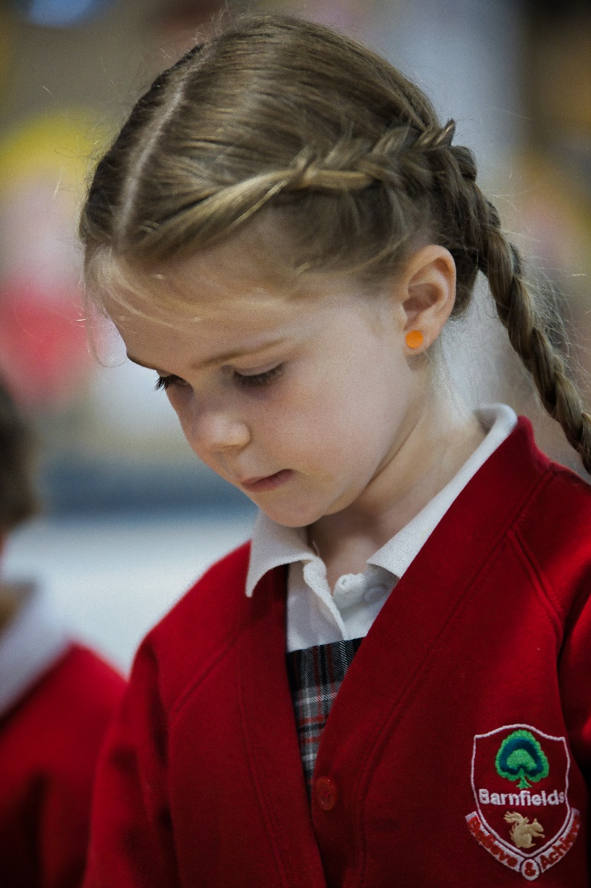
Hair Accessories
We expect hairstyles to be presentable and smart without being too extreme. Long hair must be tied back for PE. During lesson time, we encourage hair to be tied back so not to hinder their learning.
Accessories, such as headbands, need to be sensible in appearance and size.
Notes:
JM

Slide 10



Barnfields’ Behaviour Policy: Principles
Notes:
The Barnfields’ Behaviour Policy is underpinned by three principles. These are READY, RESPECTFUL AND SAFE. Each principle refers to an element of the children’s behaviours and will be consistently addressed through the use of a common language around each area. JM

Slide 11

Barnfields’ Behaviour Policy: Rewards
Daily: Verbal praise, celebration of work in class, stickers, sent to partner year group teacher/Phase Leader, raffle ticket reward (drawn at end of week)
Weekly: Phase Leader sticker, email to parents, Hot Chocolate Friday with Phase Leader, raffle ticket draw, Celebration Assembly (Well Done)
Half-termly: Postcards home from Headteacher, Reward Afternoon, a golden band to wear, Acorn Award Assembly
Termly: Squirrel Award Assembly, Reward Day
Notes:
Explain here that children will always be encouraged to demonstrate appropriate and acceptable behaviours and work towards the rewards for showing good behaviour. However, on some occasions the children will need to be reminded of what acceptable behaviour looks like and sanctions may be needed when they demonstrate inappropriate behaviours. The levels of behaviour and sanctions are set out in the school’s behaviour policy on the website. Please just make them aware of these levels. JM

Slide 12
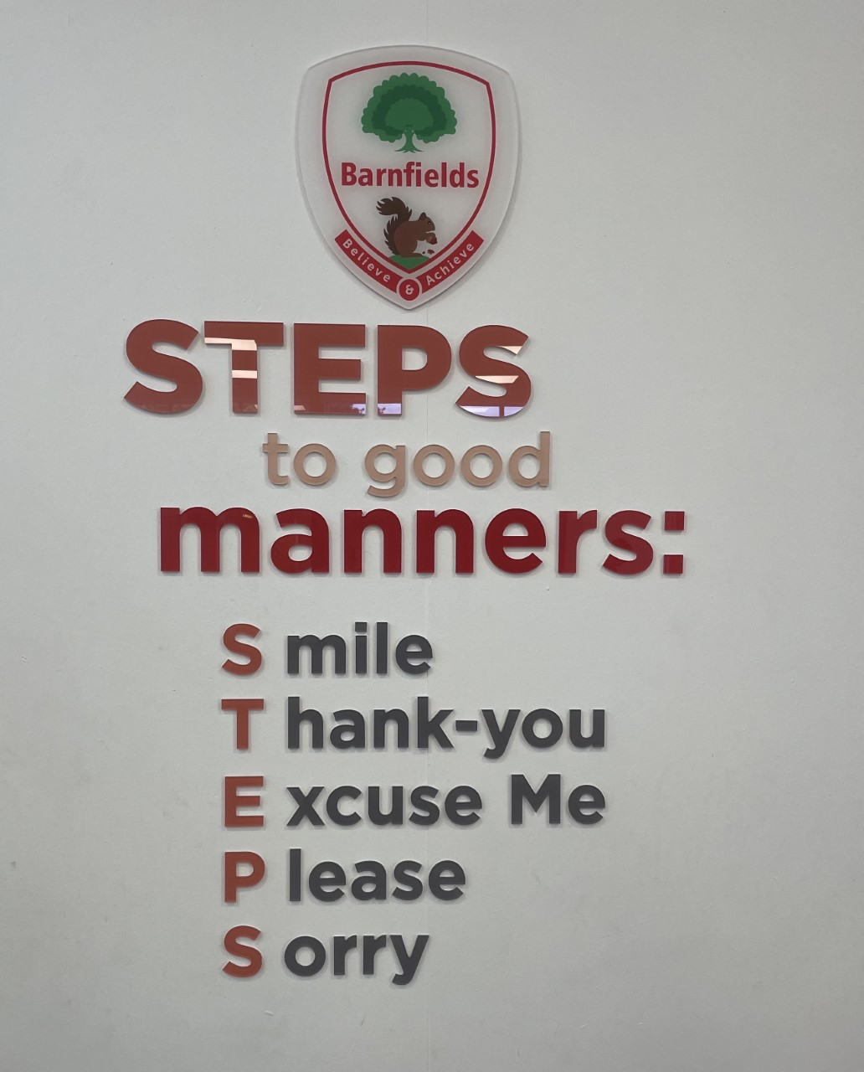
Barnfields’ Behaviour Policy: STEPS to Good Manners
We believe it is important that children learn through example so we actively teach the STEPS to good manners:
Smile
Thank you
Excuse me
Please
Sorry
Notes:
Explain. JM

Slide 13
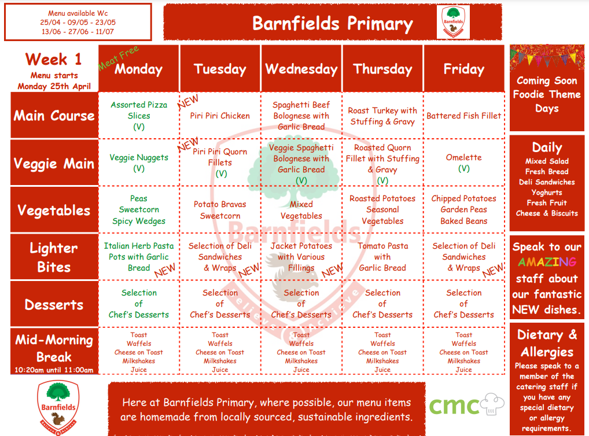
Lunch at Barnfields
Universal infant free school meals (UIFSM) provides funding for all government funded schools to offer free school meals to pupils in reception, year 1, and year 2.
Notes:
Please promote the lunches at Barnfields – this is a very important funding stream for us. Year1/2 – please really promote UFSM – these are free for all children and funding is also used to support school. ZM

Slide 14
Curriculum Intention
Our curriculum is underpinned by six key drivers: ambition, values, community, creativity, relevance and enquiry. These determine the direction and development in the work that we do.
We deliver a knowledge-engaged curriculum (we recognise that knowledge and skills are the two core components to learning).
Our curriculum encompasses the statutory requirements of the National Curriculum.
We offer a broad and balanced curriculum that values the discipline and importance of each subject (e.g. true to discipline).
Coherently planned and ambitious lesson sequences ensure progression of knowledge and skills within the year and throughout the years.
We understand that children learn and progress at different rates. We ensure that the curriculum is taught at the appropriate level and challenge for the stage of the child's development.
Notes:
Share our curriculum design and journey – really sell here what we do! JM

Slide 15
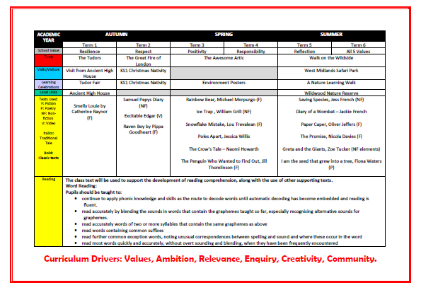
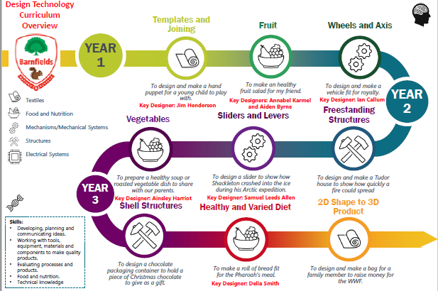
Curriculum Overviews
Notes:
Encourage the parents to visit the school website for information on the content in each subject for your year group. Really promote this, as there is now a wealth of published curriculum mapping for them to access. JM

Slide 16

English Expectations: Reading
We expect children to read for at least 15 minutes every night.
This is a book of their choice but should be suited to their reading ability (90% accuracy when reading). The book can be one borrowed from school or one from home. From September children will have this book matched more consistently to their phonetic ability to help with this.
Ideally, they will read aloud to an adult to allow for opportunities to check their fluency and also discuss the content and meaning of what they have read.
In Year 2, reading has a whole class approach and is taught for half an hour four times per week. This chosen text is used to develop children's fluency and comprehension.
Notes:
ZM

Slide 17
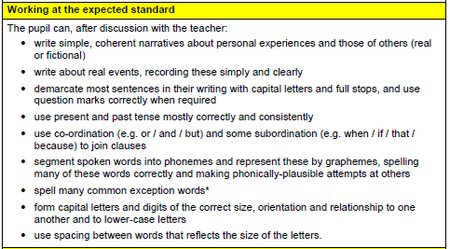
English Expectations: Writing
In Year 2, we continue to deliver our writing lessons through our Bespoke Writing Curriculum.
At the start of the writing process, pupils are exposed to many samples of the writing genre being studied.
As the writing process continues, we model writing and undertake shared and guided writing to develop the children’s knowledge and skills in readiness for the independent writing they then complete.
Once the children have completed their writing, we will model how to compose, edit and revise their writing. Your child will be taught to self-evaluate their writing and check their work independently for sense, accuracy and meaning.
Spelling, vocabulary, grammar and punctuation are taught in the context of pupils’ own writing, as well as through discrete lessons.
Notes:
ZM

Slide 18
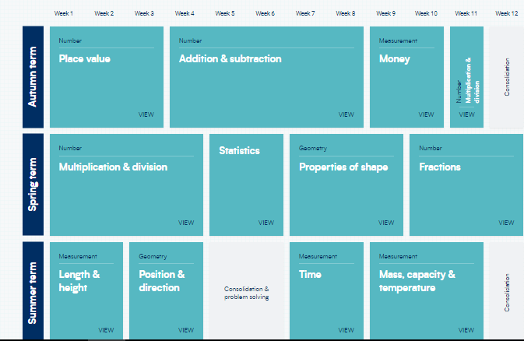
Expectations: Mathematics
Notes:
ZM

Slide 19
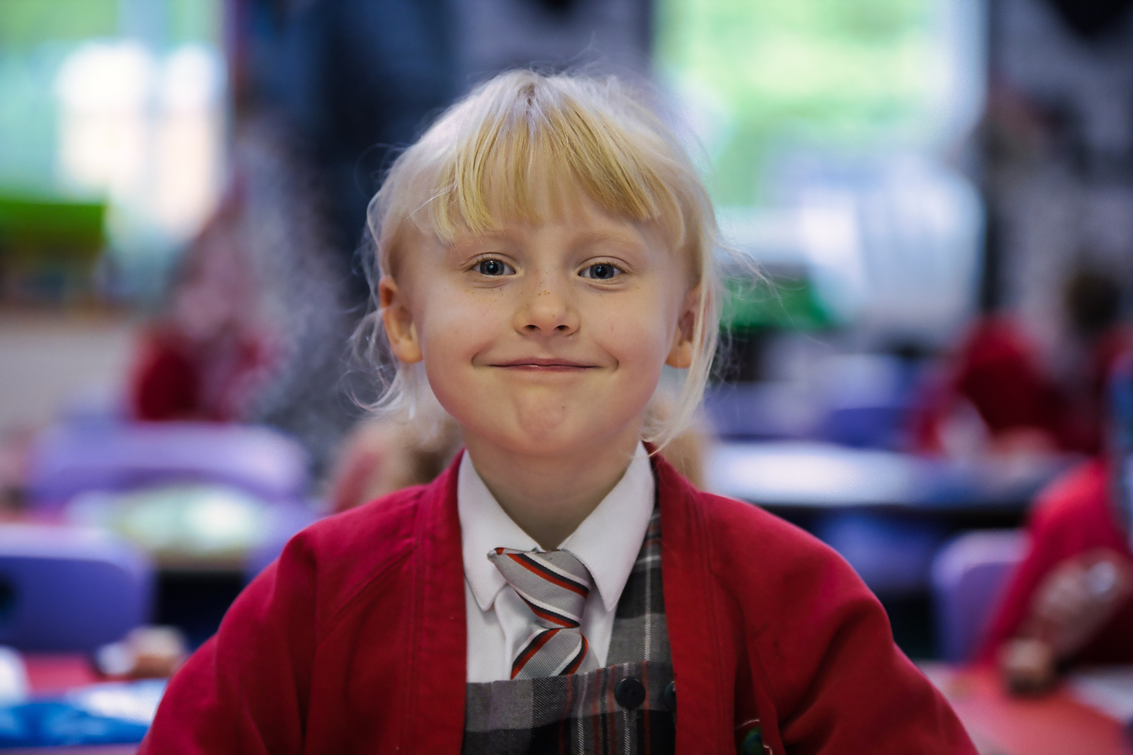
Reporting to Parents
As in previous years, a report will be sent out to parents at the end of each term, enabling you to track your child’s attainment and progress throughout the year.
 | Autumn 1 | Autumn 2 | Spring 1 | Spring 2 | Summer 1 | Summer 2
Expected | 1S+ | 2B | 2B+ | 2W | 2W+ | 2S
Exceeding | 2B | 2B+ | 2W | 2W+ | 2S | 2S+
Progress | Autumn 1 | Autumn 2 | Spring 1 | Spring 2 | Summer 1 | Summer2
Expected | 1 step | 2 steps | 3 steps | 4 steps | 5 steps | 6 steps
Notes:
Please adapt so it is appropriate for your year group. Explain the process of assessment and reporting JM

Slide 20



Parental Support
At home, you can help your child by:
Reading
Reading with your child for 15 minutes a day is the most important way you can impact your child’s education.
Practising multiplication tables
We provide the children with Times Tables Rock Stars, which is a brilliant site for learning and consolidating their tables! By the end of Year 2 they need to know their 2x, 5x and 10x tables. We also have the White Rose APP as well as other great web-sites like Hit the Button!
Practising the Statutory Year 2 spellings
Please refer to the handout to see the Year 2 spelling list. Alongside this, working on handwriting is also really beneficial.
We will also set weekly homework. This is optional and will be an add on to any in class work. We don’t need to have this handed back into school.
Notes:
JM

Slide 21

SATS
Sats in Key Stage 1 are more informal in terms of structure and time. Children have the whole of May to sit them.
Nativity
Confirmation of this date will be sent out in the new year but we are initially looking at the week of the 12 December.
Notes:
JM

Slide 22
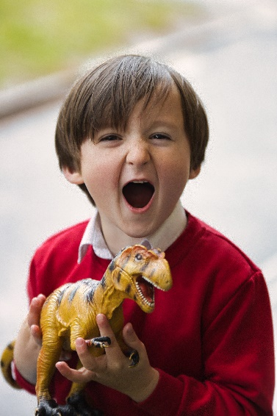

Keeping in Touch
Email: office@barnfields.staffs.sch.uk
Mr Ball: headteacher@barnfields.staffs.sch.uk
Mrs Darlington: deputy@barnfields.staffs.sch.uk
Mrs Davies (SENCO): senco_BP@barnfields.staffs.sch.uk
We also publish Barnfields’ Bulletin every two weeks which contains important information, such as any upcoming events.
We also have a very active Twitter account.
Follow us @BarnfieldsPS
Notes:
Please do not give out your email address. Contact should be made via the school office in the first instance, or alternatively at the end of the school day. Explain that we have an ‘open door’ policy and encourage parent-school relationships.
Allow time at the end for any questions.

