Slide 1

Barnfields Primary School
Year 6
SCHOOL VISION:
At Barnfields, academic excellence runs alongside sporting and artistic excellence. The whole child is nurtured as positive wellbeing is encouraged and supported, enabling them to make outstanding progress across the curriculum. This learning is underpinned by strong values that encourage and guide the children through the rest of their academic journey and as citizens of the future.
Responsibility Reflection Positivity Resilience Respect

Slide 2
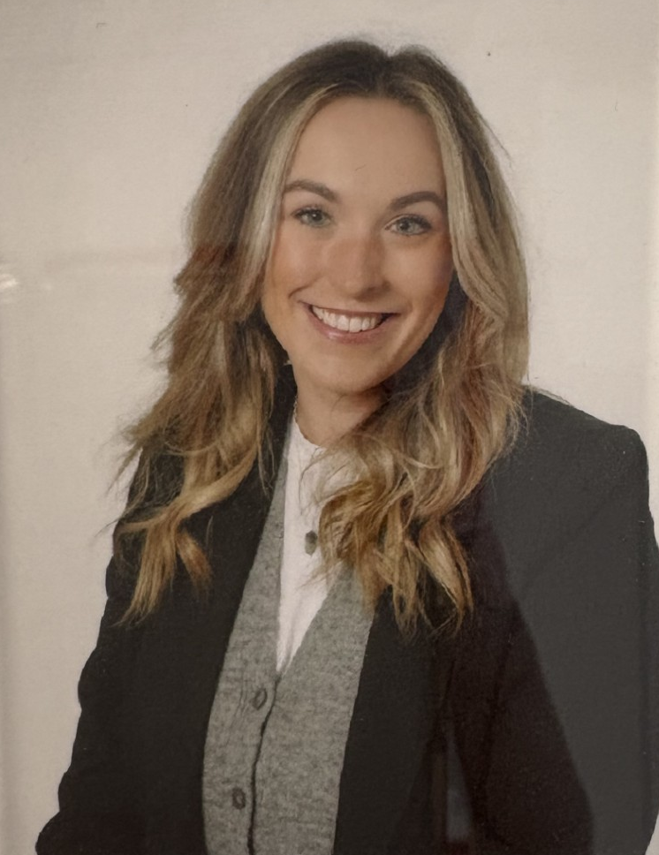
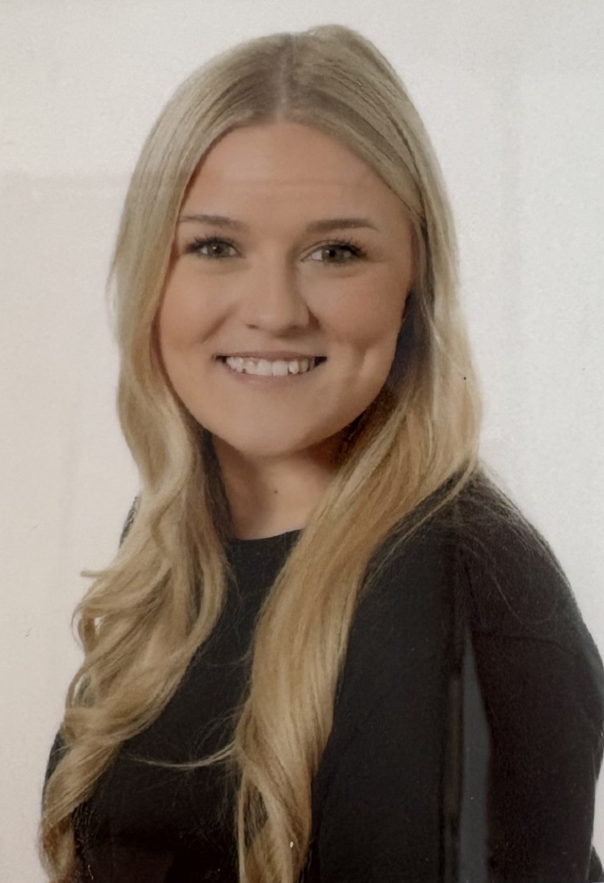
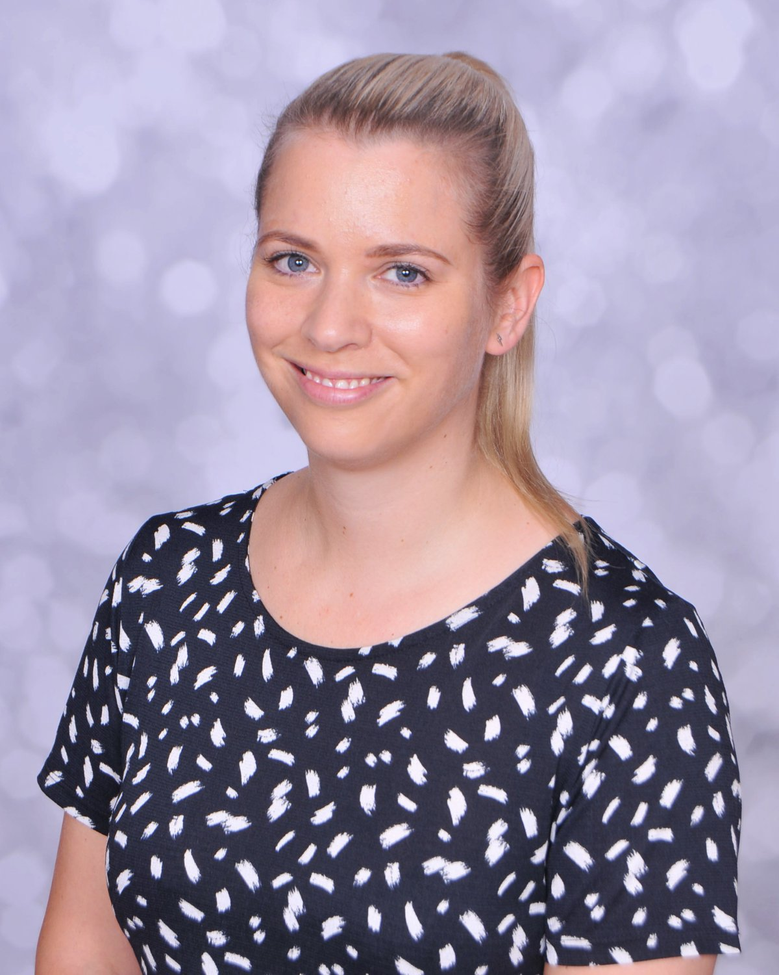
Meet the Teachers
Mrs Taylor
Class Teacher
Miss McCulloch
Class Teacher
Mrs Crosland-Nash
UKS2 Phase Leader

Slide 3
Year 6 Timings of the Day
Gates open at 8:40 and close promptly at 8:50. If your child arrives after this, they will need to be taken to the office to register there.
Break time is 10:40 – 10:55. The children will be able to bring in some money to buy a snack from the kitchen.
Lunch time is 12:00 – 13:00.
Children will be dismissed from the bottom gate at 15:20.
If you wish for your child to walk home by themselves, please ensure you sign the permission slip and ask your child to hand it in to the class teacher.
Please help us start promptly by ensuring your child arrives at school on time.
Learning begins promptly at 8:50 AM.

Slide 4
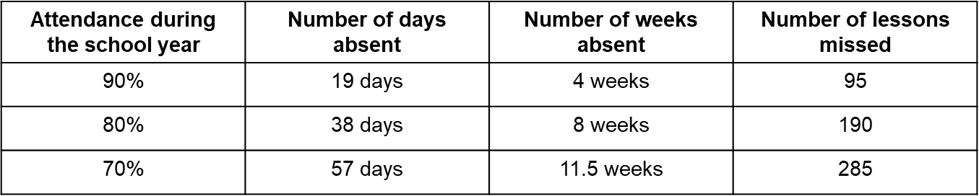

The Importance of Attendance
Regular school attendance is the key to enabling children and young people to maximise the educational opportunities available to them and become emotionally resilient, confident and competent adults who are able to realise their full potential and make a positive contribution to their community. Promoting excellent attendance is the responsibility of the whole school community.

Slide 5
Contact with School Staff
If you need to contact us, email the school office at office@barnfields.staffs.sch.uk. Your email will be acknowledged and actioned, with a response back within 48 hours.
For urgent messages, please contact the school office, who will inform the necessary staff immediately.
Alternatively, you may speak with us at the end of the school day during pick up.
The Senior Leadership Team open the gates each morning and are available should you require assistance at the start of the day.
For safeguarding purposes, if your child is going home with another child or family, please ensure that a message is communicated to the school in advance.
Parents appreciate the school. In their comments to Ofsted, many praised the quality of leadership, learning and care provided for their children’ Ofsted 2024

Slide 6
Provisional Dates
1st September – Inset Day
2nd September – Children return back to school
22nd and 23rd October – Parents Evening
24th October – Inset Day
3rd November – 7th November – Year 6 Residential
19th December – Inset Day
5th January – Inset Day
January (TBC) Young Voices
11th and 12th February – Parents Evening
March TBC – Walton Pyramid Concert
6th March – World Book Day
11th – 14th May – SATs
25th June – UKS2 Sports Day
7th and 8th July – Year 6 Production
The school calendar on website is updated regularly; it can be found under
Parent News
School Trips will be confirmed in September

Slide 7

Home-School Partnership

Slide 8

Home-School Partnership
Stay Connected with the Arbor App!
We are encouraging all parents to download and start using the new Arbor app, which offers a range of useful features, including:
Communications from school (via push notifications)
Reporting absences quickly and easily.
Paying for school trips and other items
We’ll continue to expand its use and features from September onwards.

Slide 9
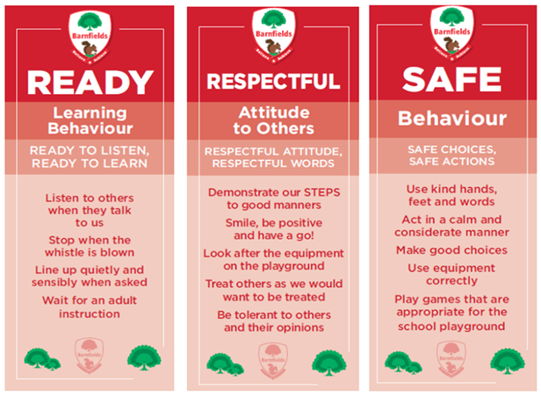
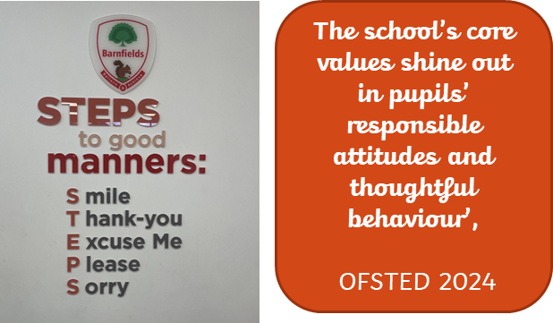
Promoting Excellent Attitudes and Behaviours at Barnfields

Slide 10
Rewards and Celebrations
Daily: Verbal praise, celebration of work in class, stickers, sent to partner year group teacher/Phase Leader, raffle ticket reward (drawn at end of week)
Weekly: Phase Leader sticker, email to parents, Hot Chocolate Friday with Phase Leader, raffle ticket draw, Celebration Assembly (Well Done)
Half-termly: Postcards home from Headteacher, Reward Afternoon, a golden band to wear
Termly: Award Assembly, Reward Day

Slide 11
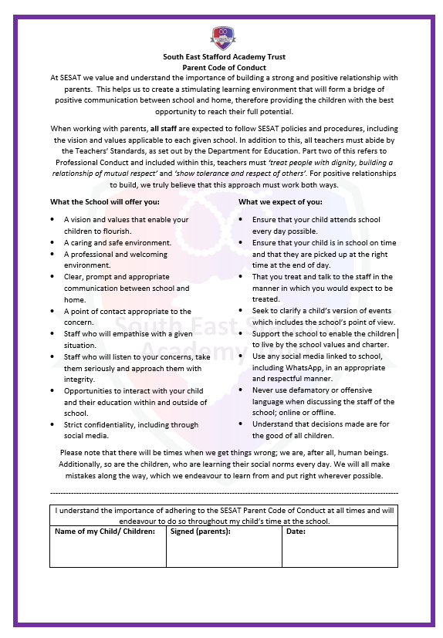
Parent Code of Conduct
At Barnfields, we strongly believe that a positive and honest relationship between home and school is essential to your child’s education.
This year, we have created a Parent Code of Conduct, which clearly outlines what we will strive to provide for you and what we expect in return. Please take a copy to read, agree to, and sign before returning it to the school as soon as possible. Kindly note that this agreement only needs to be signed once during your child’s time at Barnfields.
This will be sent out in September by the school office.

Slide 12
Books, Images and Videos Parental Consent
Working together is central to our teaching and learning approach.
We proudly share images of children engaged in group activities and learning experiences. At the end of the year, we would love to celebrate your child's progress by sending some books home. Please note, permission is required for this.
Other photo and video permissions (such as for social media or the school website) are optional.
We are always careful about what we share, why, and how we share images. We also need permission before taking group photographs.
If you wish to update your child’s permission settings, please contact the school office staff.

Slide 13
Year Group Timetable
Typical Mornings:
Core subjects: Reading, Writing, Spelling and Mathematics
Typical Afternoons:
Science (Core Subject), Geography, History, Art, Design & Technology, Computing, PSHE, PE and RE, Music, French and other wider curriculum related activities.
All children will begin the afternoon with reading time or time to improve mathematical fluency.
PE days: To be confirmed in September.
PE: Children must be able to remove earrings by themselves. Plasters are not permitted.

Slide 14
Curriculum Intention
Our curriculum is underpinned by six key drivers: ambition, values, knowledge, retrieval, relevance and enquiry. These determine the direction and development in the work that we do.
We deliver a knowledge-engaged curriculum (we recognise that knowledge and skills are the two core components to learning).
Our curriculum encompasses the statutory requirements of the National Curriculum.
We offer a broad and balanced curriculum that values the discipline and importance of each subject (e.g. true to discipline).
Coherently planned and ambitious lesson sequences ensure progression of knowledge and skills within the year and throughout the years.
We understand that children learn and progress at different rates. We ensure that the curriculum is taught at the appropriate level and challenge for the stage of the child's development.

Slide 15

Curriculum Outlines
Explore Our Curriculum Online
We encourage you to visit our school website to find detailed information about the curriculum for your child’s year group.
A wealth of curriculum mapping is available to support your understanding of what your child is learning.
Curriculum maps will be refreshed and updated at the start of September – keep an eye out for the latest versions!

Slide 16

English Expectations: Reading
By the end of Year 6, your child should be reading a wide range of texts confidently, including fiction, non-fiction, poetry and plays.
They should be able to read fluently and aloud with expression, understanding tricky words by using clues in the text.
Your child will be expected to understand and explain what they read, including picking out key ideas, spotting themes, and making inferences.
They should be able to justify their opinions with evidence from the text and explain how authors use language, layout and structure to create effects.
Talking about books is also important – they should confidently share their opinions, compare different authors, and discuss how stories or messages are similar or different across texts.
A big factor in this success is the school’s highly effective approach to teaching reading, OFSTED 2024

Slide 17
Reading at Home
Reading is vital and proficient reading ability is strongly linked to success in later life. Just a few minutes each day adds up! On average…
Role model reading for pleasure at home – children see, children do.
Reading supports children’s learning through fostering better attention, brain development and cognitive ability.
Readers have better speech and language development and literacy skills. It also develops imagination, empathy and creativity.
20 minutes a day = | 5 minutes a day = | 1 minute a day =
1.8 million words per year | 282,000 words per year | 8,000 words per year

Slide 18



Selecting Appropriate Books: Book Trust

Slide 19
Parental Support: Reading
Let your child choose books: interest is key.
Offer a mix of fiction, nonfiction, graphic novels, and series books.
Create a routine: set aside a regular time for reading (e.g. 15–30 minutes before bed).
Make it a conversation: encourage talking about the book—reading is not just about decoding, but understanding and enjoying.
Take turns reading a page or paragraph.
Model fluency and expression.
Help decode unfamiliar words and explain them in context.
After reading, ask open questions like: What did you like/dislike? What do you think will happen next? Which character do you relate to and why? Encourage children to explain their thoughts using evidence from the book.
Listen to audiobooks together.
Try reading poetry or short stories and discussing structure or themes.

Slide 20
English Expectations: Writing
By the end of Year 6, your child should be writing in a clear, organised and imaginative way for a range of audiences and purposes, such as stories, letters, reports and persuasive texts.
They should be able to use a wide range of vocabulary and choose words carefully for effect.
Their sentences should be varied and include different types, such as questions, commands and complex sentences.
Children are expected to use accurate grammar, spelling and punctuation, including commas, colons, semi-colons and dashes.
They should also be confident in editing and improving their writing by checking for clarity, accuracy and impact.
In addition, handwriting should be neat, legible, and mostly joined.

Slide 21
Parental Support: Writing
Give your child a fun prompt to spark creativity: What if you could time travel for one day? Write about a mysterious door in your school. Just 5–10 minutes a day builds confidence and fluency.
Make writing meaningful by using it in everyday life: Write a letter to a family member. Create a shopping list or recipe. Review a favourite book, game or film.
Keep a writer’s journal: A notebook just for ideas, doodles, new words or short stories.
We will provide grammar homework weekly, please ensure your child completes this!

Slide 22
Mathematics Expectations
By the end of Year 6, your child should have a strong understanding of number, including working confidently with larger numbers (up to 10 million), decimals, fractions and percentages.
They should be able to use the four operations – addition, subtraction, multiplication and division – to solve multi-step problems with accuracy and reasoning.
Children are expected to know their times tables up to 12×12 and apply this knowledge to fractions, ratios and algebra.
They should understand and use measurement, including converting between units (like cm to m or g to kg), and calculate area, perimeter and volume.
They will describe and draw shapes, work with angles, and use coordinates in all four quadrants.
Children will also interpret and construct charts, graphs and data tables, and apply maths to real-life situations.
Children should also explain their reasoning clearly, showing how they reached an answer.

Slide 23
Parental Support: Mathematics
Practice times tables regularly (up to 12x12) using apps, or quick-fire games at home.
Do mental maths challenges together, like adding or multiplying in your head while cooking or walking.
Focus on quick recall of number facts, including division, doubles/halves, and number bonds.
Use maths in everyday life - involve your child in shopping: estimate costs, calculate change, or compare prices and deals.
Use recipes to explore fractions, weights, and converting units (e.g. grams to kilograms).
Talk about time and timetables, especially when planning journeys or daily routines.
Play board games or card games that use maths – like Monopoly or Countdown.
Use maths apps and websites like BBC Bitesize, Topmarks, or NRICH for fun challenges.
We will provide maths homework to consolidate learning – please ensure your child completes it!
The website mathisfun.com is so helpful. It provides strategies if your child is struggling with the homework.

Slide 24

Homework
Each Friday, the children will receive one maths, one grammar and one reading piece of homework.
Each of these tasks will take them 5-10 minutes each – so they will do no more than 30 minutes of homework each week.
What has worked really well for children in Year 6 this year is to buy a nice folder to keep their homework in so that they can revise from it in the run-up to SATs!
They will bring their homework in to be marked on Fridays.

Slide 25
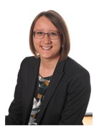
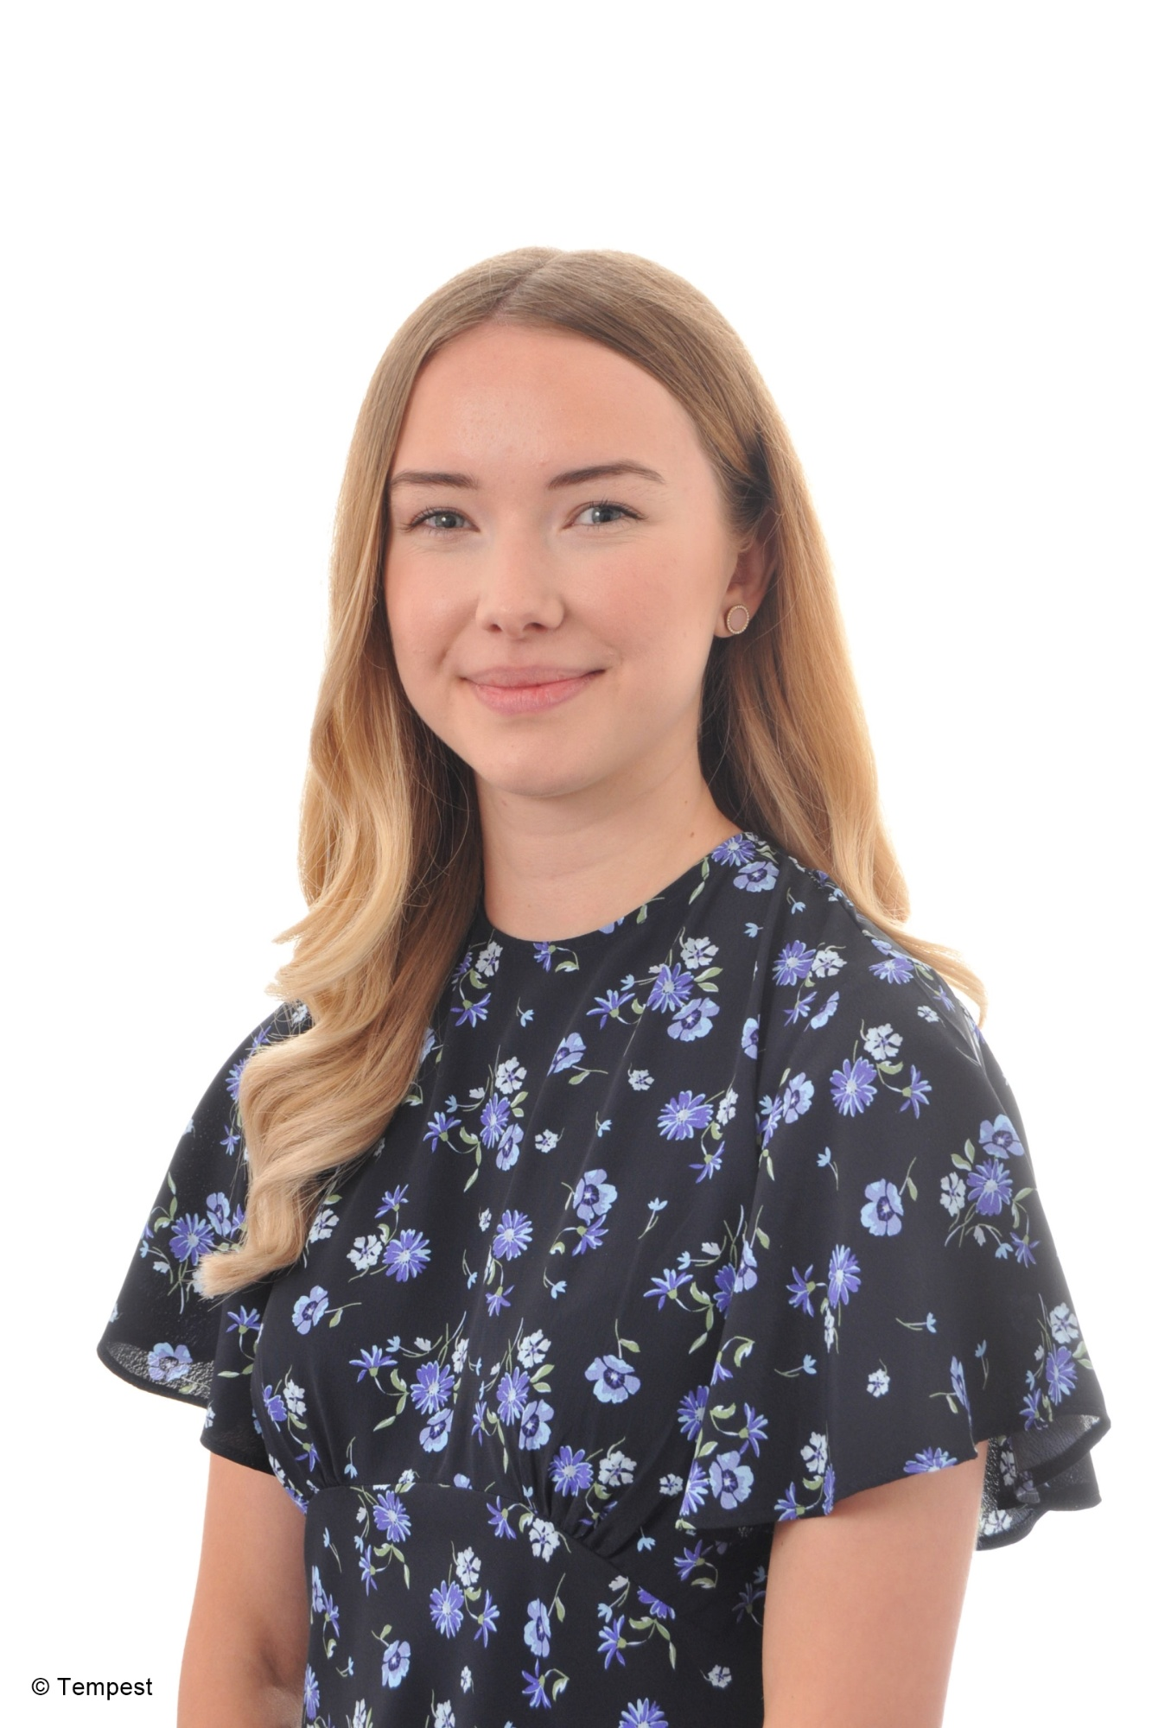
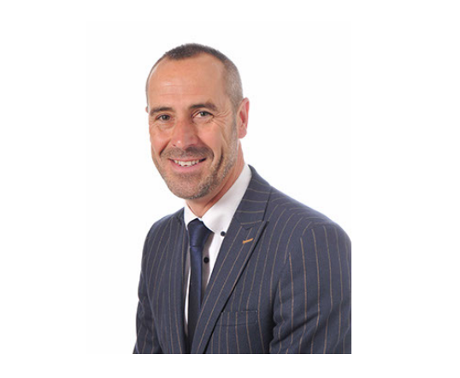
Keeping in Touch
Email: office@barnfields.staffs.sch.uk
Mr Ball: headteacher@barnfields.staffs.sch.uk
Mrs. Darlington: deputy@barnfields.staffs.sch.uk
Miss Chesworth senco_BP@barnfields.staffs.sch.uk
We also publish Barnfields’ Bulletin every two weeks which contains important information, such as any upcoming events.
Notes:
Contact should be made via the school office in the first instance, or alternatively at the end of the school day.

