Slide 1

Barnfields Primary School
Y4 Multiplication Tables Check (MTC)
Meeting for parents and carers
Tuesday 3rd February 2026

Slide 2

Aims for the session
To explain the rationale of the check
To look at how the check will be implemented
To discuss ways in which the children can be supported at home

Slide 3
Why are times tables important?
As part of the National Curriculum, all children are expected to know their times tables up to 12 x 12 by the end of Y4.
Times tables are fundamental in supporting children’s learning and underpin many aspects of the Maths curriculum. It is vital that all children know their multiplication facts up to 12 x 12.
Knowing the multiplication facts up to 12x 12, will give them the essential knowledge needed to be proficient with Years 5 and 6 Curriculum.

Slide 4
Purpose of the check:
The purpose of the check is to determine whether your child can fluently recall their times tables up to 12x12, which is essential for future success in mathematics. It will also help us to identify if your child may need additional support with learning these moving forward.

Slide 5
Access for all children
There are several access arrangements available for the check, these can be used to support pupils with specific needs. Your child’s teacher will ensure that the access arrangements are appropriate for your child before they take the check in June. The check has been designed so that it is inclusive and accessible to as many children as possible, including those with special educational needs or disability (SEND) or English as an additional language (EAL). However, there may be some circumstances in which it will not be appropriate for a pupil to take the check, even when using suitable access arrangements. If you have any concerns about your child accessing the check, you should discuss this with your child’s teacher.

Slide 6
When is it?
The check is for all Year Four pupils and takes place within the 2-week period from Monday 1 June 2026. As a school, we will implement the assessment during this time in small groups and in a calm and stress-free way.

Slide 7
What does the multiplication check involve?
It is an on-screen check consisting of 25 times table questions. Your child will be able to answer 3 practice questions before taking the actual check. They will then have 6 seconds to answer each question. On average, the check should take no longer than 5 minutes to complete.

Slide 8
Will I find out my child’s score?
Yes. Your child’s teacher will share your child’s score with you, as they would with all national curriculum assessments. There is no pass mark for the check.

Slide 9

What can I do to support my child?
We practise our times tables daily at school; we would love for your children to practise with you at home so that they feel confident when completing the test.
The easiest way is to quiz your child.
E.g. 8x6 is?
Encourage children to practise on Timestables.co.uk as often as possible. We intend for the children to complete the check using tablets and so it would be useful if children could also practise using touchscreens at home if possible.
Quiz your child at home regularly. This could be when making dinner or on the journey to school.

Slide 10
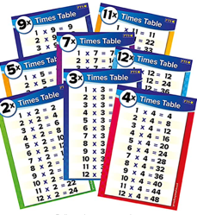
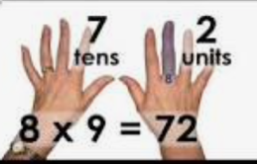
Display a poster with all of the times tables facts on at home.
We teach lots of tricks to help the children remember the times tables. You could learn a trick together.
Create flash cards with your children and let them play with friends, siblings, grandparents. They could write the answer on the back and test themselves.

Slide 11
Any questions?
Thank you so much for attending this meeting.
We really value your support.

