Slide 1

Barnfields Primary School
Year 1
SCHOOL VISION:
At Barnfields, academic excellence runs alongside sporting and artistic excellence. The whole child is nurtured as positive wellbeing is encouraged and supported, enabling them to make outstanding progress across the curriculum. This learning is underpinned by strong values that encourage and guide the children through the rest of their academic journey and as citizens of the future.
Responsibility Reflection Positivity Resilience Respect
Notes:
LAURA Please share the school vision, particularly the three aspects of the school vision (academic, sporting and artistic)

Slide 2
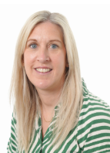

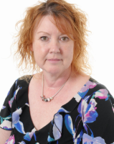
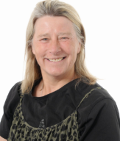
Meet the Teachers
Mrs Turton
Year 1 teacher
KS1 Phase Leader
Mrs Russell
Teaching Assistant
Miss Dean
Teaching Assistant
Miss Taylor
Year 1 teacher
Notes:
LAURA Adapt to include the Phase Leader, teachers and support staff

Slide 3
Year 1 Timings of the Day
Start of the day - Gate opens at 8:40am and closes at 8:50am. Year 1 will enter through the side school gate as they did in Reception. Please help us start promptly by ensuring your child arrives at school on time. Learning begins promptly at 8:50am.
Break time - 10:20am – 10:35am
Lunch time – 11:45 am – 12:45pm
Afternoon break – 2:05pm – 2:15pm
End of the day – Children will be dismissed from the main school gate at 3:20pm.
Notes:
CLAIREAdapt so it is specific to your year group only

Slide 4
Year Group Timetable
Typical Mornings:
Core subjects: Reading, Writing, Phonics and Mathematics
Typical Afternoons:
Science (Core Subject) + Geography, History, Art, Design & Technology, Computing, PSHE, PE and RE, Music and other wider curriculum related activities.
All children will begin the afternoon with a Handwriting session.
PE days: Both sessions are on a Tuesday and Wednesday with the class teacher and Mrs Whittaker
PE: Children must be able to remove earrings by themselves. Plasters are not permitted.
Notes:
CLAIRE Adapt so it is specific to your year group only

Slide 5
Provisional Dates
School Trips – Hoo Zoo Autumn Term to support Science
Family Learning events that will be held during the year –
Autumn 1: September 30 2026 Yr1 Parent Phonics Workshop (9:30am & 5:30pm)
Autumn 2 Christmas Hand Puppet workshop (Design Technology)
Spring 2 : Watercolour Landscape Painting (Art)
The school calendar on website is updated regularly (under
Parent News)
Notes:
LAURA TBC – working on these now!

Slide 6
Statutory Assessments
During the Summer Term of Year 1, children take part in the Phonics Screening Check, a national assessment designed to check their phonics knowledge and understanding.
The Phonics Screening Check will take place during the week commencing 14 June 2027.We will be holding a Year 1 Phonics Information Meeting on 30 September, where we will explain how phonics is taught in Year 1 and how you can support your child’s phonics development at home.
We will also hold a further meeting during the Summer Term, where we will provide more information about how the Phonics Screening Check is carried out and share practical ways you can support your child at home in preparation for the check.
Notes:
LAURA TBC – working on these now!

Slide 7
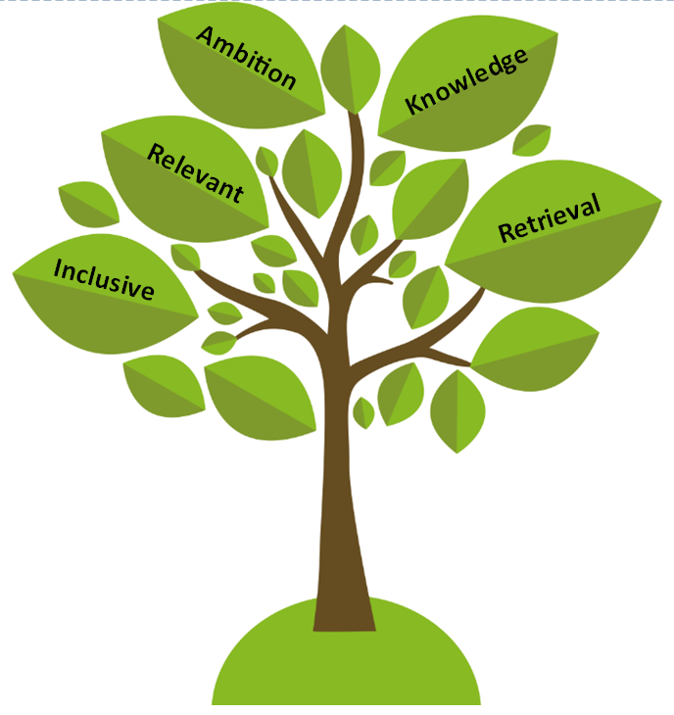



Curriculum Outlines
Curriculum Drivers: Ambition, Knowledge, Relevant, Retrieval and Inclusive
Notes:
CLAIRE Note –these will be sent out in Sep as there are a few adaptations.
Will include all subject areas
Share the Autumn Term texts the children are using.
Encourage the parents to visit the school website for information on the content in each subject for your year group.
Really promote this, as there is now a wealth of published curriculum mapping for them to access.

Slide 8
Curriculum Units
Subject | Units
History | History of Barnfields, Kings and Queens, Fantastic Females
Geography | Barnfields and Wildwood, Weather patterns, Discover the United Kingdom
Art | Spirals (Molly Haslund), Watercolours (Emma Burleigh), Playful Making (Andrea Butler)
Design and Technology | Textiles: Hand Puppets; Mechanisms: wheels and axles, Food and Nutrition: Fruit salads
Computing | Technology around us, Moving a Robot, Grouping Data, Digital Printing, Digital Writing, Programming animations
Music | Old school hip-hop, Reggae and Hip-hop, Blues, Latin, folk, funk, baroque, bhangra, Latin Bossa Nova, Film music, Big Band Jazz, Mash-up, Latin fusion, pop
PE | Football, Handball, Gymnastics, golf, Dance, Volleyball, orienteering, rounders, fitness and netball.
PSHE | Being Me, Celebrating Difference, Dreams and Goals, Healthy Me, Relationships & Changing Me
RE | Creation, incarnation, Beliefs, salvation, relationships with God and teachings
Curriculum Drivers: Ambition, Knowledge, Relevant, Retrieval and Inclusive
Notes:
CLAIRE

Slide 9

English Expectations: Reading
Word Reading
Building on the foundations laid in Reception, children will apply phonic knowledge and skills as the route to decode words and begin reading accurately by blending sounds in unfamiliar words. They will read common exception words, read words with contractions [for example, I’m, I’ll, we’ll], and understand that the apostrophe represents the omitted letter(s). They will re-read these books to build up their fluency and confidence in word reading.
Comprehension
Children should develop a love for reading including vocabulary, and comprehension by engaging with a wide range of texts beyond their independent reading level. This includes listening to and discussing poems, stories, and non-fiction, connecting texts to their own experiences, becoming familiar with key stories and their features, joining in with repeated phrases, enjoying rhymes and poems, and learning new vocabulary in context.
They should also understand texts by using prior knowledge, checking for meaning, discussing key elements like titles and events, making inferences, and predicting outcomes. During Year 1 they will participate in discussions, turn-taking, listening to others, and clearly explaining their understanding.
A big factor in this success is the school’s highly effective approach to teaching reading, OFSTED 2024
Notes:
LAURA Make specific reference here to year group NC content

Slide 10
Reading at Home
Reading is vital and proficient reading ability is strongly linked to success in later life. Just a few minutes each day adds up! On average…
Role model reading for pleasure at home – children see, children do.
Reading supports children’s learning through fostering better attention, brain development and cognitive ability.
Readers have better speech and language development and literacy skills. It also develops imagination, empathy and creativity.
20 minutes a day = | 5 minutes a day = | 1 minute a day =
1.8 million words per year | 282,000 words per year | 8,000 words per year
Notes:
LAURA

Slide 11



Selecting Appropriate Books: Book Trust
Notes:
LAURA

Slide 12

Parental Support: Reading
Reading Diaries will be used to support children with securing early fluency.
Reading regularly with your child at home (15 minutes a day) is the most important way you can impact your child’s education. To check children’s understanding, discuss what they have read by asking simple questions such as “What do you think will happen next?” or “Why do you think the character did that?”.
Most importantly, encouraging a love of
reading will help build confidence and fluency.
Notes:
LAURA Ideas for how parents can help with reading

Slide 13
English Expectations: Writing
By the end of Year 1, children should be writing in clear sentences with spaces between words, using capital letters and full stops, and starting to use question and exclamation marks.
They will also begin to organise their thoughts, with sentences planned aloud and written in order, often using ideas from their own experiences.
Their writing should be becoming more varied, with the inclusion of lists, captions, or instructions, and they’re starting to check their work for clarity.
In terms of spelling and handwriting, they should be spelling familiar words correctly, using prefixes and suffixes, and practicing the proper formation of letters and numbers. They are also refining their pencil grip and letter orientation.
Notes:
LAURA Make specific reference here to year group NC content

Slide 14
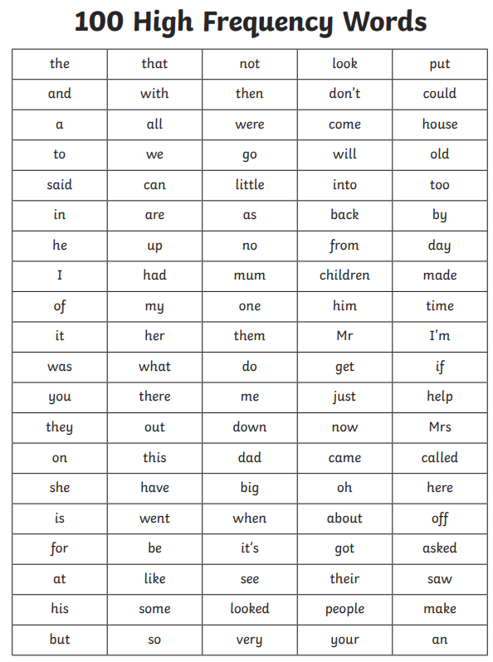
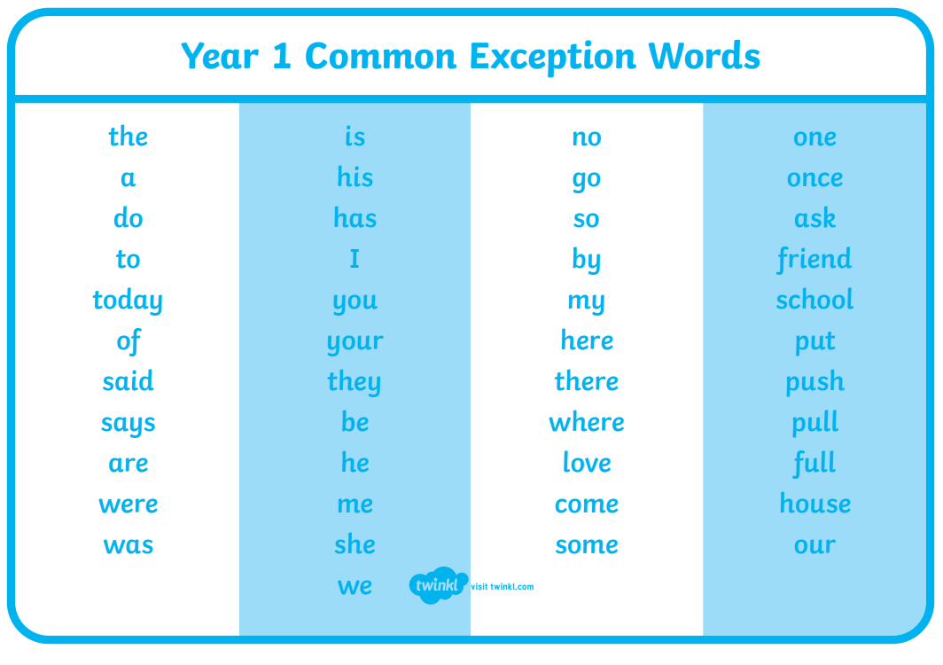
Parental Support: Writing
Encouraging fun written activities at home (stories, lists, lyrics, etc) is a great way to get your child writing at home. Praise effort and creativity as confidence is just as important as accuracy at this stage.
Notes:
LAURA Ideas for how parents can help with writing

Slide 15
Phonics
Phonics is taught daily in Year 1. At the beginning of the year, the majority of children will be taught phonics by their class teacher.
Following our Autumn 1 assessment, we will review the children’s progress and regroup them where appropriate. This ensures that the phonics teaching and content delivered are carefully matched to each child’s individual needs and stage of development.
Some children may benefit from a little additional support with their phonics. Mrs Stephens runs a daily ‘Keep-Up’ session in the afternoon, with children identified by their class teacher based on their individual needs.
Notes:
LAURA

Slide 16
Mathematics Expectations
By the end of Year 1, children are expected to develop a strong understanding of numbers and basic arithmetic. They will learn to count forwards and backwards up to 100, recognise numbers up to 20, and write them in both numerals and words.
Children will practice simple addition and subtraction, using concrete objects, pictures, and number lines to help solve problems. They will explore number bonds (pairs of numbers that add up to a specific total) and begin to understand the concepts of "more than," "less than," and "equal to."
In addition, they will work with basic multiplication and division concepts, learn about shape, measure length, weight, and capacity, and solve simple problems involving time and money.
Notes:
CLAIREMention following white rose and

Slide 17
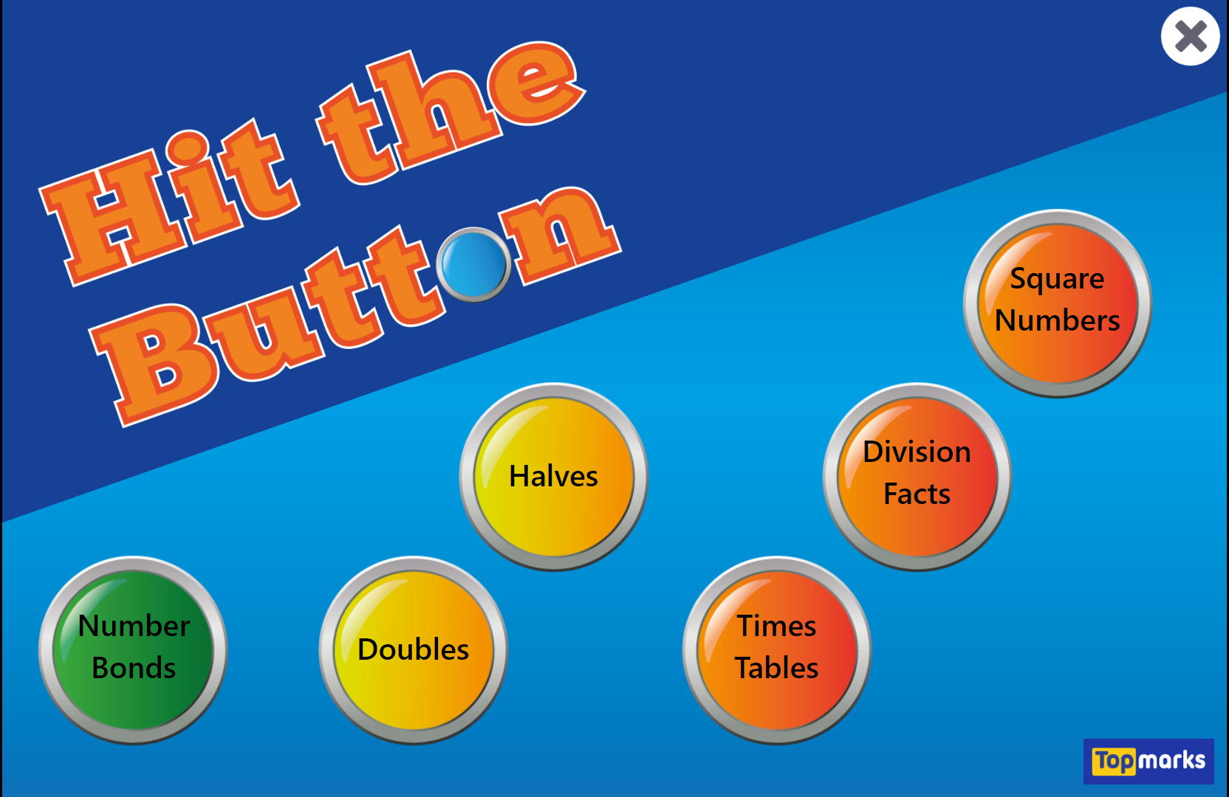
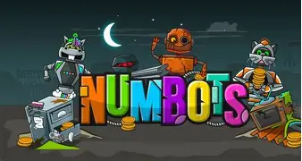
Parental Support: Mathematics
Counting Together: Encourage your child to count forwards and backwards, starting from any number. You can do this while walking, in the car, or during everyday activities. Try counting in 2s, 5s, and 10s for added challenge.
Use Everyday Objects: Use items around the house, like toys, food, or buttons, to teach addition and subtraction. For example, “You have 3 apples, and I give you 2 more. How many do you have now?”
Practice Number Bonds: Help your child practice number bonds to 10 and 20 (e.g., 5 + 5 = 10, 7 + 3 = 10, etc.). You can make it fun by turning it into a game with cards or dice.
Work on Simple Problems: Ask your child simple one-step addition or subtraction questions like, "If you have 7 apples and I take away 3, how many are left?" You can use objects to help them visualise the problem.
Use Games and Apps: There are lots of fun, educational maths apps and games that can help your child practice their skills in an interactive way.
Notes:
CLAIREIdeas of how parents can help with maths

Slide 18

RSHE Curriculum
From September 2026, all schools are required to teach the updated statutory RSHE curriculum. We have updated our Jigsaw PSHE programme to ensure it fully meets the new Department for Education guidance while continuing to deliver age-appropriate, inclusive and engaging lessons.
How we teach RSHE
Our lessons are delivered through the Jigsaw PSHE programme and are designed to:
build confidence and resilience
help children keep themselves safe
encourage respectful, healthy relationships
prepare children for life in modern Britain
provide a safe environment where pupils can ask questions and discuss important issues appropriately.
Further information, including our curriculum overview and parent resources, will be available on the school website and parents are always welcome to speak to their child's class teacher or the PSHE lead with any questions.
What has changed?
Online safety has been strengthened, including: AI and deepfakes , online scams and misinformation, healthy online relationships and digital footprints and privacy
Greater emphasis on respectful relationships, kindness and recognising unhealthy or harmful behaviour.
Children will develop a stronger understanding of consent, personal boundaries and seeking help from trusted adults.
Health education now includes more learning about: mental wellbeing, managing emotions, healthy lifestyles, body changes and puberty (age appropriate)
Lessons continue to promote equality, inclusion, diversity and respect for all.
What stays the same?
Lessons remain age appropriate and carefully sequenced from Year 1 to Year 6.
Relationships Education and Health Education are statutory for all primary pupils.
Parents retain the right to request withdrawal from the non-statutory Sex Education lessons that are beyond the National Curriculum for Science.
Science lessons about human growth, reproduction and puberty remain part of the National Curriculum and cannot be withdrawn from.
Notes:
CLAIRE Please add in a new slide on the RSHE Curriculum for September 2026. All this can be found on Jigsaw in the Sep 2026 section. Parents will receive a letter before Summer 2 outlining the Changing Me Unit in more detail.

Slide 19
Homework
Homework will be sent out weekly every Friday. This will be a piece of work to consolidate the learning taking place in school and will cover a range of subjects over the weeks.
This should not be onerous and should take no longer than 20 minutes.
Notes:
CLAIRE State how homework will work

Slide 20

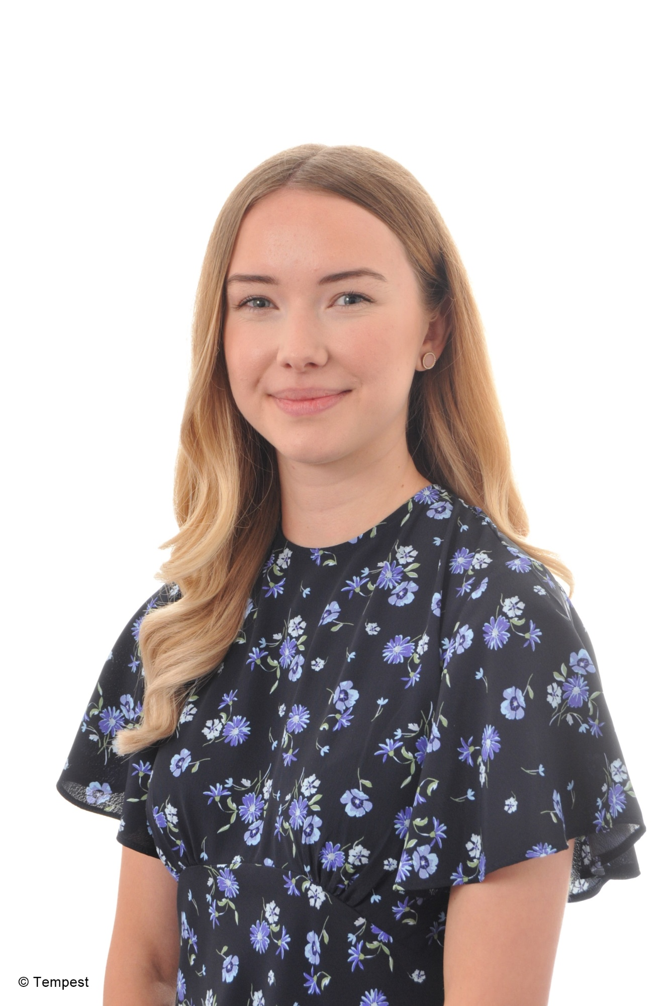
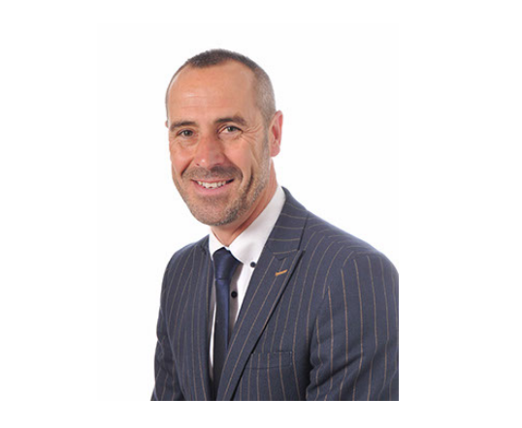
Keeping in Touch
Email: office@barnfields.staffs.sch.uk
Mr Ball: headteacher@barnfields.staffs.sch.uk
Mrs. Darlington: deputy@barnfields.staffs.sch.uk
Mrs Chesworth-Hull senco_BP@barnfields.staffs.sch.uk
If you need to contact us, email the school office at office@barnfields.staffs.sch.uk. Your email will be acknowledged and actioned, with a response back within 48 hours. For urgent messages, please contact the school office, who will inform the necessary staff immediately.
Notes:
LAURA Please do not give out your email address. Contact should be made via the school office in the first instance, or alternatively at the end of the school day. Explain that we have an ‘open door’ policy and encourage parent-school relationships.
Allow time at the end for any questions.

